Slide 1
ASSIGNMENT-01
By- DEEP TUKARAM BHOYAR
17-01-2023.

Slide 2
The difference between data and information.
Data
Information
It refers to raw facts which one gathers about something and are bare and random.
They are text, numbers, symbols and more
Data does not depend on information
We measure data in bits and bytes
It may or may not come in use
Information are facts regarding something put into context which are refined through processing
It is refined data
We cannot process information without data
We measure information in units of
Information always come in usetime, quantity and more

Slide 3
How is data useful for us?
Below are the 5 major points where data is useful for us.
For Informed Decision-Making
For Problem-Solving
For Greater Understanding
For Improving Processes
For Understanding Behaviour

Slide 4
What is BIG DATA ?
Big Data is a collection of data that is huge in volume, yet growing exponentially with time. It is a data with so large size and complexity that none of traditional data management tools can store it or process it efficiently. Big data is also a data but with huge size.
The New York Stock Exchange is an example of Big Data that generates about one terabyte of new trade data per day.

Slide 5
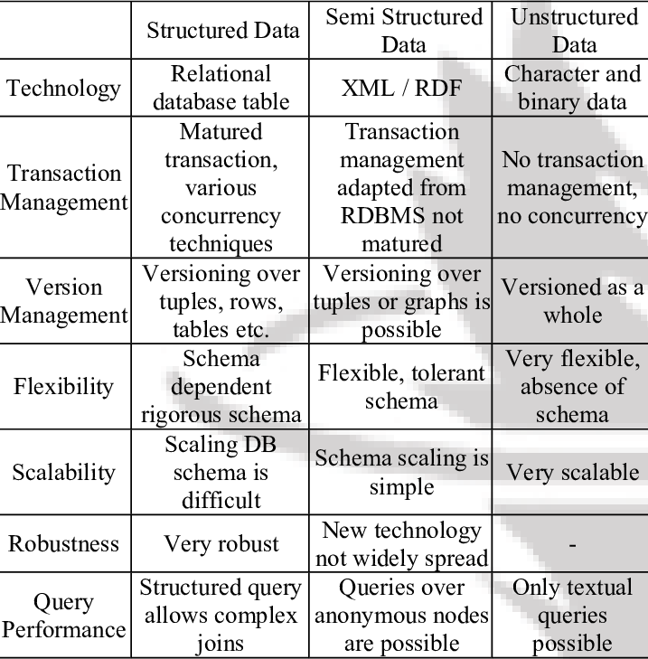
Difference between structured, semi structured and un structured data.

Slide 6
What is quantitative and qualitative data?
Qualitative
Quantitative
Qualitative data is non-statistical and is typically unstructured or semi-structured. This data isn’t necessarily measured using hard numbers used to develop graphs and charts. Instead, it is categorized based on properties, attributes, labels, and other identifiers.
Qualitative data can be used to ask the question “why.” It is investigative and is often open-ended until further research is conducted. Generating this data from qualitative research is used for theorizations, interpretations, developing hypotheses, and initial understandings.
Contrary to qualitative data, quantitative data is statistical and is typically structured in nature – meaning it is more rigid and defined. This data type is measured using numbers and values, making it a more suitable candidate for data analysis.
Whereas qualitative is open for exploration, quantitative data is much more concise and close-ended. It can be used to ask the questions “how much” or “how many,” followed by conclusive information.

Slide 7
The V’s in BIG DATA.
1. Volume
2. Velocity
3. Variety
4. Veracity
5. Value
6. Variability .Variability

Slide 8
Tools used in BIG DATA
1. APACHE Hadoop
2. Cassandra
3. Qubole
4. Xplenty
5. Spark
6.Mongo DB
7. Apache Storm
8. SAS.

Slide 9
Types of data.
The data is classified into majorly four categories:
Nominal data.
Ordinal data.
Discrete data.
Continuous data.

Slide 10
Qualitative or Categorical Data
Qualitative or Categorical Data is data that can’t be measured or counted in the form of numbers. These types of data are sorted by category, not by number. That’s why it is also known as Categorical Data. These data consist of audio, images, symbols, or text. The gender of a person, i.e., male, female, or others, is qualitative data.
Qualitative data tells about the perception of people. This data helps market researchers understand the customers’ tastes and then design their ideas and strategies accordingly.

Slide 11
Nominal Data
Nominal Data is used to label variables without any order or quantitative value. The color of hair can be considered nominal data, as one color can’t be compared with another color.
The name “nominal” comes from the Latin name “nomen,” which means “name.” With the help of nominal data, we can’t do any numerical tasks or can’t give any order to sort the data. These data don’t have any meaningful order; their values are distributed into distinct categories.

Slide 12
Ordinal Data
Ordinal data have natural ordering where a number is present in some kind of order by their position on the scale. These data are used for observation like customer satisfaction, happiness, etc., but we can’t do any arithmetical tasks on them.
Ordinal data is qualitative data for which their values have some kind of relative position. These kinds of data can be considered “in-between” qualitative and quantitative data. The ordinal data only shows the sequences and cannot use for statistical analysis. Compared to nominal data, ordinal data have some kind of order that is not present in nominal data.

Slide 13
Quantitative Data
Quantitative data can be expressed in numerical values, making it countable and including statistical data analysis. These kinds of data are also known as Numerical data. It answers the questions like “how much,” “how many,” and “how often.” For example, the price of a phone, the computer’s ram, the height or weight of a person, etc., falls under quantitative data.
Quantitative data can be used for statistical manipulation. These data can be represented on a wide variety of graphs and charts, such as bar graphs, histograms, scatter plots, boxplots, pie charts, line graphs, etc.

Slide 14
Discrete Data
The term discrete means distinct or separate. The discrete data contain the values that fall under integers or whole numbers. The total number of students in a class is an example of discrete data. These data can’t be broken into decimal or fraction values.
The discrete data are countable and have finite values; their subdivision is not possible. These data are represented mainly by a bar graph, number line, or frequency table.

Slide 15
Continuous Data
Continuous data are in the form of fractional numbers. It can be the version of an android phone, the height of a person, the length of an object, etc. Continuous data represents information that can be divided into smaller levels. The continuous variable can take any value within a range.
The key difference between discrete and continuous data is that discrete data contains the integer or whole number. Still, continuous data stores the fractional numbers to record different types of data such as temperature, height, width, time, speed, etc.

